Slide 1
2025 SPRING BMS DATA SCIENCE CHALLENGE
Project 1 - Data Cleaning Dashboard
SRUTHI BALU
MSDS - Rutgers University

Slide 2
OBJECTIVE
COMPILE DATA
DATA QUALITY
VISUALIZE DATA
GENERATE REPORTS
Develop an interactive and user-friendly Data Cleaning Dashboard that helps scientists and analysts detect, visualize, and resolve data quality issues across multiple datasets.
Combine files from various formats (CSV, XLSX, XLSM) with automated header mapping.
Identify and correct missing values, duplicates, and inconsistent formats.
Enable users to view outliers, unique values, and column-level insights interactively.
Export validated datasets and metadata for downstream analysis.

Slide 3






TECHNOLOGY STACK
Dash (Python web framework) Frontend Framework
Dash Bootstrap Components (DBC) UI Components
Pandas, NumPy Data Processing
Plotly Express/Graph Objects Visualization
SciPy Statistical Analysis
Dash Uploader, Base64 encoding File Handling

Slide 4
WORKFLOW
STEP 1: FILE UPLOAD
STEP 2: DATA COMPILATION
STEP 3: QUALITY ANALYSIS
STEP 4: INTERACTIVE CLEANING
STEP 5: DATA VISUALIZATION
STEP 6: FILE EXPORT

Slide 5
STEP 1: FILE UPLOAD
FEATURES
AUTO-GENERATED
CSV, XLSX, XLSM support
Upto 5 files, 200MB each
Optional Template Upload
File summary
Header comparison
Data Preview

Slide 6
STEP 2: DATA COMPILATION
SMART FEATURES
AUTO-GENERATED
Fuzzy header mapping
Manual header mapping
Skip unwanted columns
Quick reset/map all
Handle different headers
Remove duplicates
Case-insensitive categories

Slide 7
STEP 3: QUALITY ANALYSIS
MISSING VALUES
OUTPUT
FORMAT ISSUES
OUTLIERS
DUPLICATES
Count & percentage per column
Prioritized cleaning steps
Color-coded severity
Column recommendations
Summary statistics
Date & numeric inconsistencies
Z-score Detection
Record Identification

Slide 8
STEP 4: INTERACTIVE CLEANING
MISSING VALUES
OUTLIER HANDLING
DUPLICATE REMOVAL
FORMAT CORRECTION
VALUE ROUNDING
HISTORY TRACKING

Slide 9

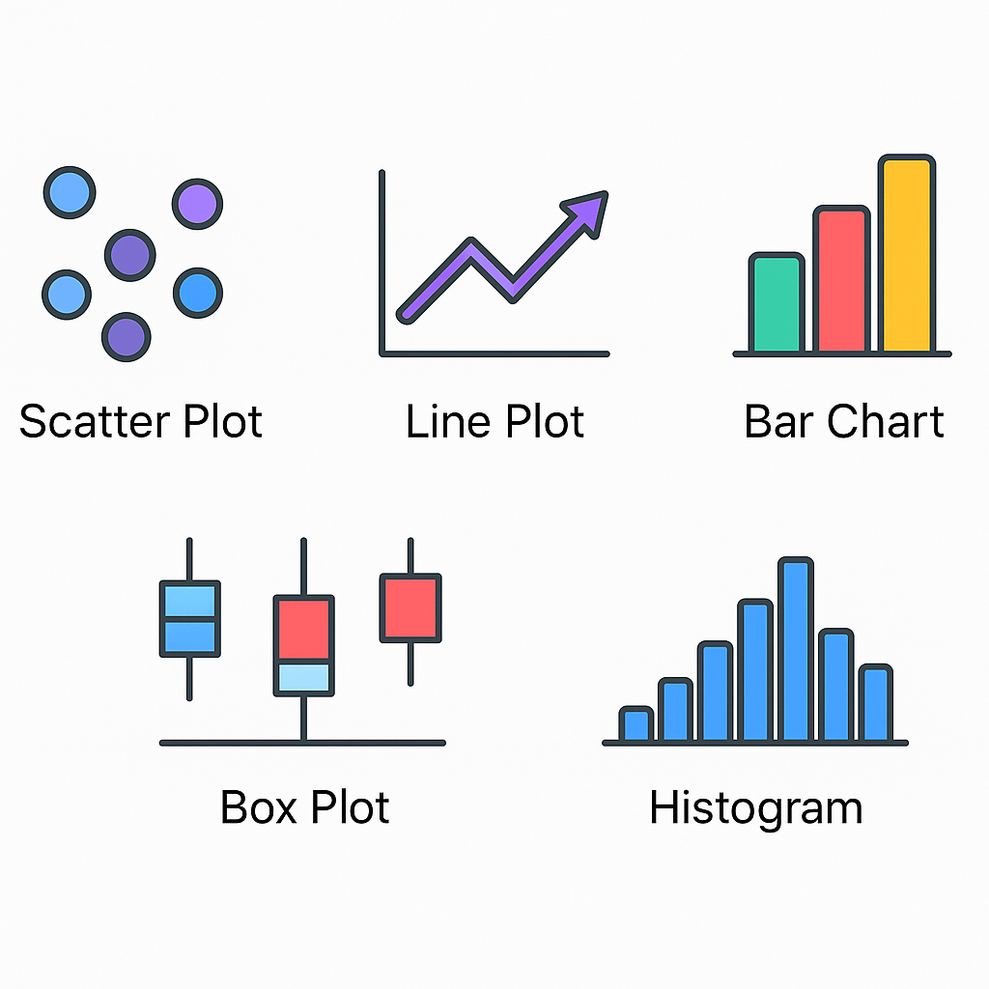

STEP 5: DATA VISUALIZATION

Slide 10
STEP 6: FILE EXPORT
.xlsx
.csv
METADATA
Cleaned data
Metadata and Statistics
Simple CSV or Zip file
Metadata and Statistics
Export Info
Cleaning History
Column statistics

Slide 11

DEMO

Slide 12
THANK YOU

